Slide 1
CyNC 2013
Cybercrime Network
Conference
Greek Cybercrime Centre
www.cybercc.gr

Slide 2
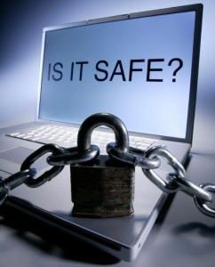
GCC: Dissemination: CyberCrime
CyberCrime (CC) comprises (EU definition):
Traditional forms of crime such as fraud or forgery, committed over electronic communication networks and information systems;
Publication of illegal content over electronic media (e.g., child sexual abuse material, or incitement to racial hatred);
Crimes unique to electronic networks, e.g., attacks against information systems, denial of service and hacking.

Slide 3

GCC: Dissemination: CyberCrime
Defence Costs
Cost to Society
Measuring the
Cost of Cybercrime *
Indirect Losses
Direct Losses
Criminal Revenues
Cybercrimes
Supporting Infrastructure
* Commissioned by the UK Ministry of Defence, 2012

Slide 4
GCC: Dissemination: CyberCrime
Cybersecurity Cost-Benefit
9/11
  Cost of attack: $0.5m
  Cost of defence: $3,000,000m
  Ratio: 1:6,000,000!
2010 SPAM:
  Earned @2.7m (from illegal pharmaceuticals)
  Cost of SPAM to ISPs: Many billions $.
  Ratio 1:1,000

Slide 5
GCC: Dissemination: CyberCrime
Cybersecurity Cost-Benefit
Non Violent Crimes (CAN ‘03 – economy):
  Victim costs: $47bn
  Criminal justice system costs: $13bn
  Defence costs: $10bn
Robbery (UK 2005, per citizen):
  Citizen loss: £109
  Health services: £483
  Lost output: £1,011
  Distress: £3,048
R = 1:2
R = 42:1

Slide 6
GCC: Dissemination: CyberCrime
CyberCrime is like Robbery
Sentence length: Robber>Burglar>CC. Why?
Why (Defence+Indirect Costs >> Direct C.)?
  CC is multinational LE problem
  Banks/Merchants/SPs: Liability games
  CC crooks try to be invisible (opposite to terrorists)
Remedy:
  Spend less on Defence
  Spend more on LE & Punishment

Slide 7
GCC: Dissemination: CyberCrime
CyberCrime Costs to Society (in order)
Online payment card fraud
Online banking fraud
In-person payment card fraud
Fake antivirus (“Ur PC has virus”, “Run anti-virus s/w?”)
Infringing pharmaceuticals
Copyright-infringing software
Copyright-infringing music & video
`Stranded traveller' scams
`Fake escrow' scam (“won auction”, “pay ‘reputable’ escrow”)
‘Nigerian scam’
PABX fraud

Slide 8

Center for Security Studies (KEMEA)

Slide 9
Center for Security Studies - KEMEA
Established in 2005 ( with Law No 3387/2005) as the think tank on Security Policy of the Greek Ministry of Citizen Protection
KEMEA is a scientific, consulting and research agency.
  Structure:
  Governing Council (Board of Directors)
  Scientific Council
Sectors:
  Security Policy, Studies and Documentation
  Anti Criminal Policy
  International Relations and Communication
  Technology (Systems sector)

Slide 10
Center for Security Studies - KEMEA
KEMEA is:
  producing theoretical and applied research studies, particularly at a strategic level, on issues concerning security policies.
  providing advisory and consulting services to the Ministry and other national authorities and companies.
  the national contact point to the European security program for the protection of critical infrastructures (EPSIP – EU Directive 114/2008).
  represented the Hellenic Government to the European Research and Innovation Forum (ESRIF).
  also a Member to the Board of Directors of the European Organization for Security (EOS).

Slide 11
Center for Security Studies - KEMEA
KEMEA operates by Law (3387/2005) as a “flexible vehicle” of the Ministry/Agencies, for participating to European and National R&D projects as END USER, representing actually all agencies of the Ministry.
KEMEA is staffed by active officers of Police, Fire Corps and Hellenic Coast Guard as well as civilian security experts from the public/state sector. All staff members have extensive and thorough experience and expertise at the broader field of Security and Safety
Since 2007 KEMEA is successfully participated in several EC and ESA funded Projects, acting as END USER . Currently the Center is involved in 26 on going EU projects and 4 National projects in the broader area of Public Safety and Security.
KEMEA has also the ability (under his constitution law) to utilize the resources (personnel and assets) of the supervised Agencies of the Greek Ministry for Citizen Protection (Hellenic Police, Fire Corps, National Intelligence Service, and Civil Protection)

Slide 12
Center for Security Studies - KEMEA
KEMEA is:
  producing theoretical and applied research studies, particularly at a strategic level, on issues concerning security policies.
  providing advisory and consulting services to the Ministry and other national authorities and companies.
  the national contact point to the European security program for the protection of critical infrastructures (EPSIP – EU Directive 114/2008).
  represented the Hellenic Government to the European Research and Innovation Forum (ESRIF).
  also a Member to the Board of Directors of the European Organization for Security (EOS).

Slide 13
Critical Infrastructures Protection

Slide 14
Outline
Motivation and Objectives
Critical Infrastructure Description
Semantic System Modeling Aspects (The CI Modeling Challenge)
Monitoring and Stream Reasoning Process (Behavior Analyzer and NP-CUSUM )
Decision Support Tool View
Future Directions - Conclusions

Slide 15
Motivation and Objectives
Critical Infrastructures are characterized by: Increased Connectivity
Information sharing provides better Resource Optimization and Effectiveness.
Substantial Cost Reduction for Management and Systems Maintenance
Unfortunately Increased Connectivity and Data Sharing introduces new challenges on Cyber – Risks and Vulnerabilities.

Slide 16
Motivation and Objectives
Critical Infrastructures vulnerabilities
Cyber-Attacks against interconnected Information & Communication channels disrupt Exchanged Data flows and Integrity
Local Disruptions in one System is distributed to other coupled sub-Systems
Reduced Resilience against cyber-disruptions due to reduced excess capacity arising from the exchanged data.

Slide 17
R&D Objectives
Implementation of Agile Service Oriented Technologies for Multi-Stake Holder Systems for:
  Dynamic composition of ICT connections of the CI at Run-Time and NOT at Design Time.
  Dynamic monitoring of ICT components against well-defined Assets dependability criteria
  Development and Integration of Stream Reasoning and Intrusion Detection for Real Time Operator Assistance.

Slide 18
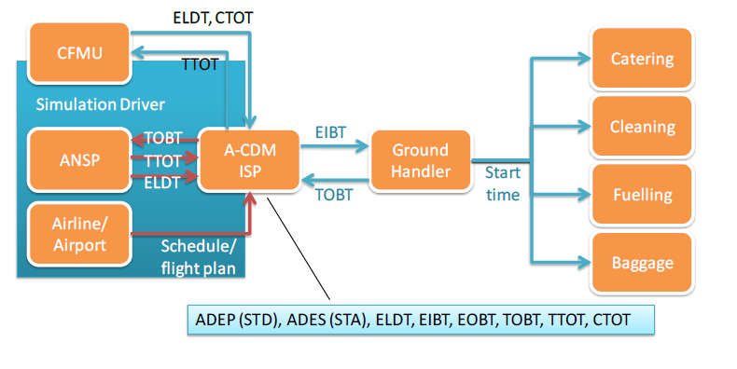
CI Desciption: An Airport-Collaborative Decision Making – European Air Traffic Management System
Services are accessible by a consumer (aircraft operator) through SLA templates.
The Ground Handler coordinates the Ramp Services (catering, fuelling, cleaning, baggage handling)
The Ground Handler: Is an Orchestrator of Ramp Services to have an aircraft ready for its next flight

Slide 19
Data quality and Key Performance Indicators (KPIs)
Data: Confidentiality, Integrity, Alarms, Data Display
KPIs: Reflect the Quality of Service Delivery
KPIs properties: Is the Quality of Time Estimates
Accuracy – Predictability - Stability
An SLA Architecture was developed with the following KPIs & Parameters in the Airport Collaborative Decision Making (A-CDM) context:
  System Availability
  Data Quality
  Data timeliness, delivery deadlines
  Confidentiality

Slide 20
Semantics Systems Modeling Aspects: The CI Modeling Challenge
The Dynamic Multi-Stakeholder system consists of 4-levels of abstraction
Core ontology structure: to model System and its assets subject to threats and protected by Counter-measures (controls).
2. Dependability model: describing system independent: assets, threats, controls. Only OWL classes and relationships are used.
Abstract system model: describes system-specific threats and counter-actions.
Concrete system model: provides snapshots of the running system and instances of the participating assets + contextualised threats & controls.

Slide 21
Brief Analysis of adopted System Ontology & CI Modeling
The Semantic Ontology is constructed so that:
Only OWL Classes are used for design-time modelling
OWL Instances are used for modelling the Run–Time System Composition
Security expertise is added at design time in the OWL classes
The Dependability model provides the first step to develop the Abstract System Model which is a Design – Time Model of the system that will be composed dynamically “On the Fly”
The Concrete Model Generator is connected to the monitoring subsystem to create a model of the Running System.
The Concrete Model is Automatically Generated from System Monitoring Data for Machine Reasoning.

Slide 22
Innovation of the Approach
The Modelling approach is constructed using Semantics Modelling for Intelligent Machine Reasoning Automated threat analysis and Risk estimation when the system is composed at “Run-Time”.
The design – time Service Oriented Dynamic models are abstract: They describe the structure but NOT the composition of the system which is NOT KNOWN until “Run-Time”.

Slide 23
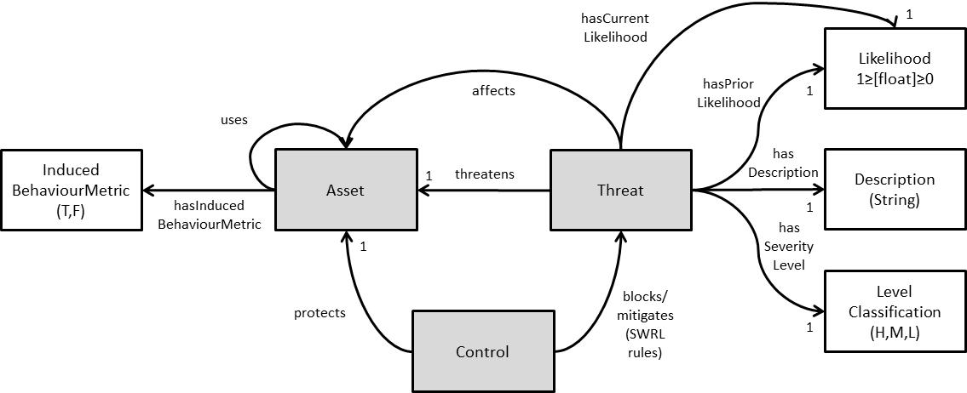
Core System Domain Ontology Schematic
This basic system structure, determines what reasoning is used

Slide 24
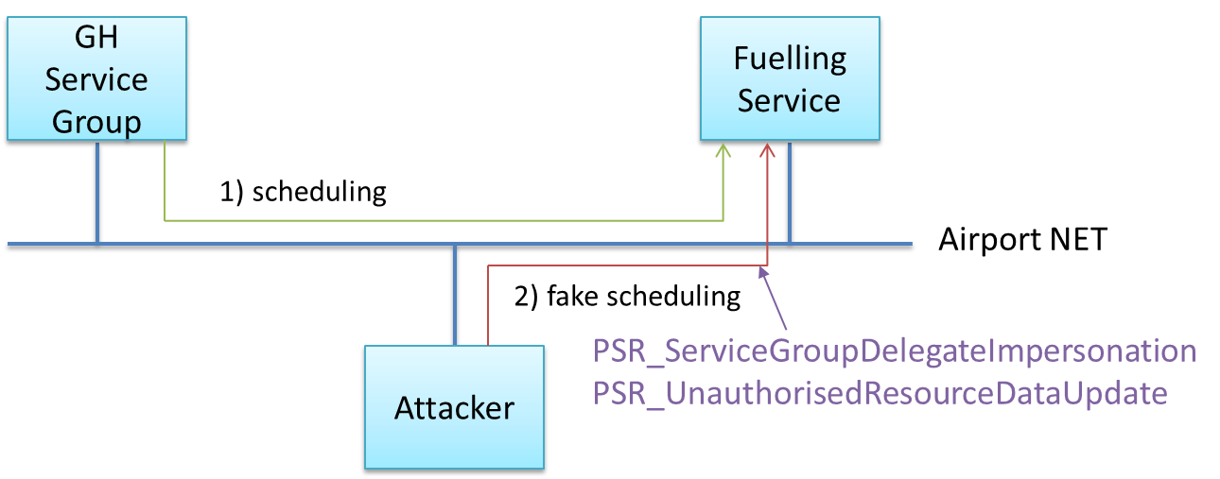
Threats & Threat Proof of Concept Scenario : Remote Exploit on Fuelling Service
Unauthorized Access (to the service)
Data traffic Snooping
Man in the Middle
Client Impersonation
Resource Failure
Unauthorized Data Update at Fuelling Service

Slide 25
Counter – Actions (Control) Class Explanation
Control (counter measure) classes provide:
generic control types that can be included directly in an abstract system model;
descriptions of deployment actions: how to deploy the control into the real system;
description of mitigation actions: how to operate reactive controls to protect assets when a threat is carried out against them.

Slide 26
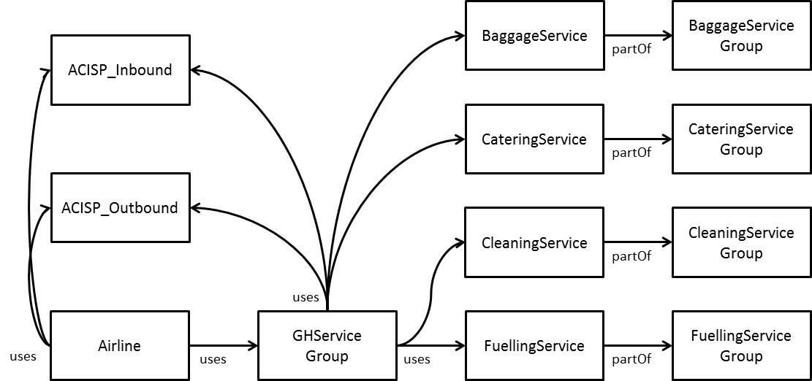
Abstract System Model of multi-stakeholder CI
It is a design-time model of the structure of the dynamic, multi-stakeholder Service-Oriented system: Input for fully automated run-time model generation and analysis Tools. It is composed dynamically at Run-Time.

Slide 27
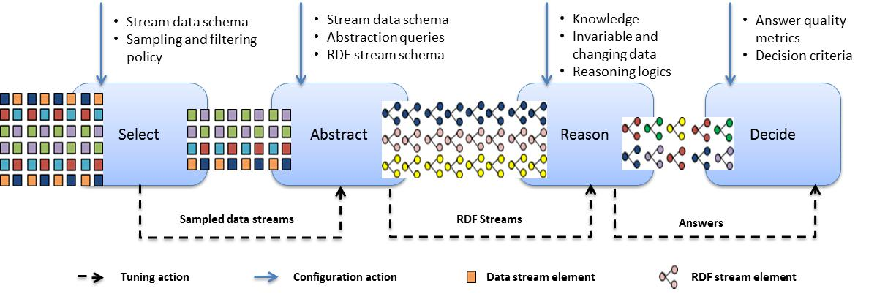
Monitoring and Stream Reasoning
Information arrives as a stream of “time-stamped” graph data
The Knowledge base is continuously updated and reasoning goals are continuously re-evaluated as new assertions arrive
Reasoning is implemented from a Finite – Time Window and not at a Single Instant !!.
Research Efforts on Stream Reasoning is still at its First Steps and its Infancy.

Slide 28
4 basic – steps in Stream Reasoning
1. Select: Relevant Data from Input Streams by using Sampling Policies that probabilistically drop stream elements to address bursty streams of data that may have unpredictable peaks.
2. Abstract: Sampled streams are input to the Abstract block to generate aggregate events by enforcing aggregate events continuously.
Output is RDF streams (ρ, τ) with ρ – RDF triple and τ – time stamp (logical arrival time of RDF statement. Use of C-SPARQL.

Slide 29
4 basic – steps in Stream Reasoning
3. Reason: RDF (Graph Streams) streams are injected into background knowledge to perform reasoning tasks. Incremental implementation of RDF snapshots.
4. Decide: Before final answers the final answering process reaches a decision step where different experts’ pre- defined metrics and criteria are used to evaluate the quality of the answer and adapt possible behaviours.

Slide 30
Semantics Driven Architecture

Slide 31
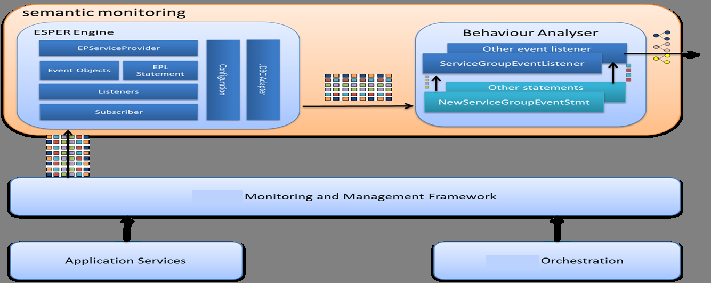
Semantic Monitoring Component
: DSMS - Behavior Analyser - Sequential Detection
DSMS: Data Stream Management System : samples & filters monitoring data generated by Service Monitoring and Management Components.
Usage of open-source CEP (Java - ESPER): Real Time engine that triggers Listeners or Subscribers using a tailored Event Processing Language (EPL).

Slide 32
Behavior Analyser (BA)
Processing of multiple data streams from DSMS. Produced Output is Graph Triples (RDF).
Decides how to convert raw monitoring data into Semantic Assertions related to: Presence of Assets and Behaviors.
The monitoring framework generates 2 – types of Time stamped RDF assertions:
(1) Presence or Absence of Assets (joining or leaving the system)
(2) Assertions about Measurability, Presence or Absence of Adverse Behavior of these Assets.

Slide 33
Behavior Analyser (BA)
The BA is not only a Transcoder converting Monitoring Events to time stamped - RDF graphs.
The BA decides about the type of Behaviors of Assets and Services.
Example: The BA is capable to determine if an Asset
is Overloaded or Underperforming using Monitoring Data for Load and Performance (KPIs – SLA events).

Slide 34
Sequential Inspection
Cumulative Sum (CUSUM) algorithm from the sequential statistics literature.
In general parametric models are used
Inspection of a Change in the mean of the relevant stochastic process
We use: The non-parametric version of CUSUM

Slide 35
NP-CUSUM basics
Non-Parametric CUSUM test
Random Data Process Sequence (transformed)

Slide 36
NP-CUSUM basics
Decision stopping rule of CUSUM
N: Attack detection threshold
Two basic contradicting performance criteria of NP-CUSUM:
i). False Alarm Time
ii). Detection Time.

Slide 37
Sequential Intrusion (Behavior) Detection
Mean Value
Attack Initiation Time and Detection Delay
Test
Statistic

Slide 38
DST – Tool Dynamic Interfaces
Scenario : Remote exploitation on Fuelling Services
AttacK: Attacker on the AirportNet network targets the Host of the Fuelling Service.
RKE: Remote Known Exploit

Slide 39
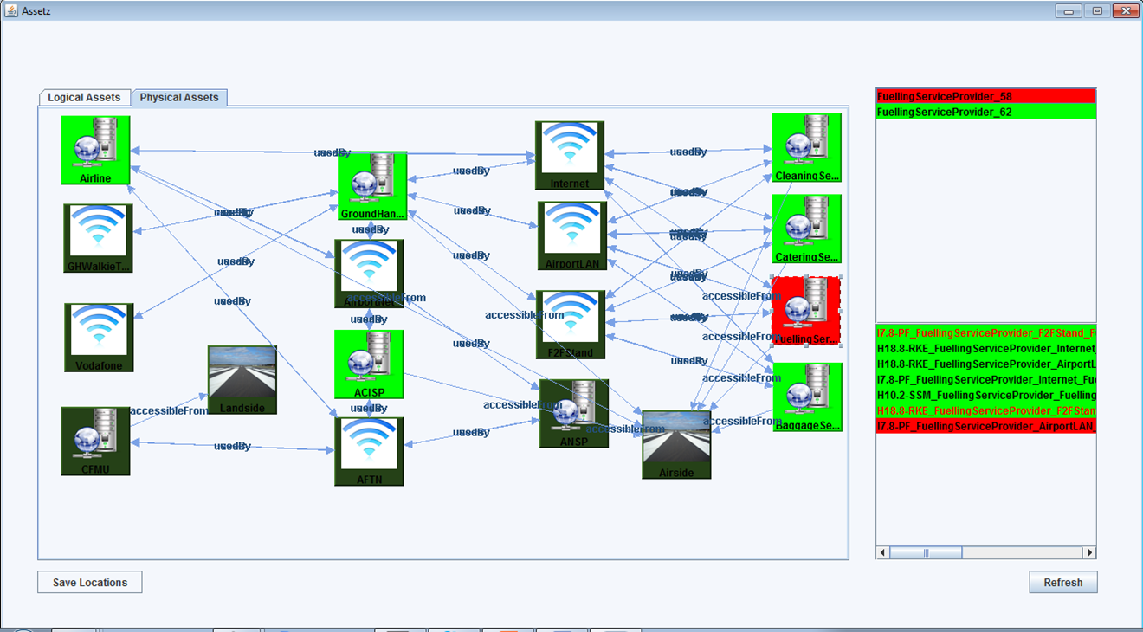
DST interface and Risk Analytics
(Threats Involving Selected Asset)

Slide 40
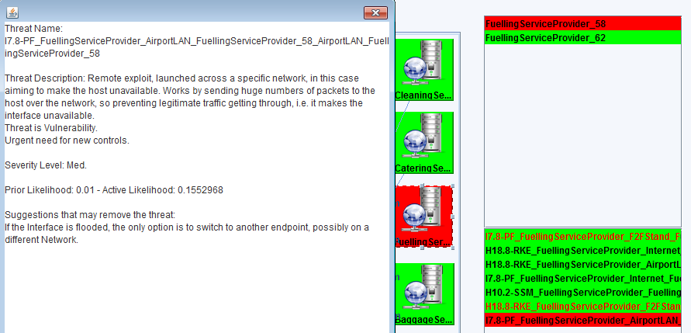
DST interface (Threat Information and Countermeasure Suggestion)

Slide 41
Future Directions
Sequential detection of a change using the nonparametric CUSUM in the Behavioral Analyzer.
Situational Awareness of the Operators using user friendly Dynamic Support Tool (DST) interfaces
Development of additional detection approaches (Sequential Probability Ratio Test, Different Optimality Criteria such as: Lorden, Shiryaev - Roberts)
Distributed Real Time Sequential Detection & Hypothesis Testing for Intrusion Attacks
Incorporate Adaptive Methods for activity Monitoring with Forward – Backward Recursive Least Squares Recursions

Slide 42


Linear Model based Process generating data for activity monitoring – RLS type algorithms
To detect Outliers and Change Points over a stream in an “On-Line” adaptive fashion !!!!.
Linear Models and Parameter Estimation.

Slide 43
Conclusions
Implementation of an Intelligent Prototype Tool for the Protection of Dynamic Multi Stakeholder SOA Critical Infrastructures. Air-traffic Management Systems PoC.
Implemented: An Innovative core ontology model which has been reinforced with rules and classes that improve threat estimation and classification.
Implemented: Advanced Stream (RDF) Reasoning – and Behavioral Analysis Algorithms.
Sequential data analysis led us to Advanced Semantic Stream Reasoning for Real –Time Processing.
Implemented: Dynamic User Interfaces with Risk – Threat Analytics in Real Time for A-CDM (Eurocontrol).

Slide 44
Security on Mobile Devices

Slide 45
Outline
Background
  Live forensics
  Android
  LiME
  Memory analysis
Testbed, experiments and scenarios
Results and discussion
Future work

Slide 46
Our topics…
Security on mobile devices and networks
2G/3G/4G security analyzer - evaluator
Forensics investigations on smart phones
Creation of groups over public networks
Intrusion detection for embedded devices
Biometric authentication
Security for Smart Grid
Security evaluation

Slide 47
Security on mobile devices & networks
We have designed and implemented an innovative security architecture that handles:
  identities, keys and security procedures (i.e., authentication, key generation, key management) on mobile devices (i.e. Android, etc.)
It follows a security-by-design approach
It supports cross layer security
Keys and security parameters can be either
  obtained from 3G, 4G, LTE, etc. subscription – network or
  generated from the characteristics of the physical layer

Slide 48
Security on mobile devices & networks
Such a security architecture can be applied
  In an Internet of things (IoT) environment
  In the provision of anonymous, micropayments, financial transactions, mobile VPN establishment, etc.
Advantages
  Reuse of the existing identification, authentication, key management and security procedures of the underlying wireless technology (2G, 3G, 4G, LTE, etc.)
  Easy installation within the existing infrastructure
  Elimination of the required typing and configuration effort by mobile users

Slide 49
2G/3G/4G security analyzer - evaluator
We have developed a SW tool that monitors all the security parameters of a mobile user
  It may provide services to individual users, or can be a security evaluation platform for operators
It records the type of network, keys, identities, location, cell id, routing area, etc.
It processes the collected data providing useful results
It can also be used for monitoring mobile users
We have developed an Android & iOS prototype
Up to now, there is no such a commercial or laboratory tool

Slide 50
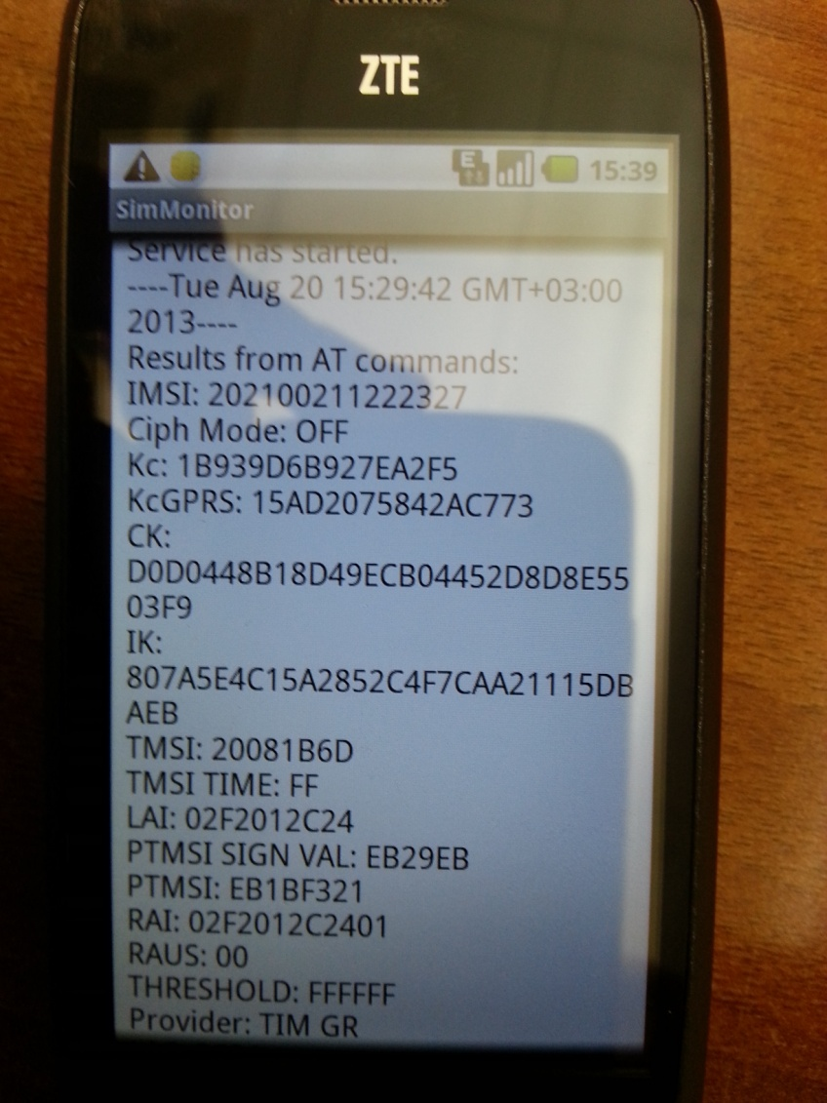
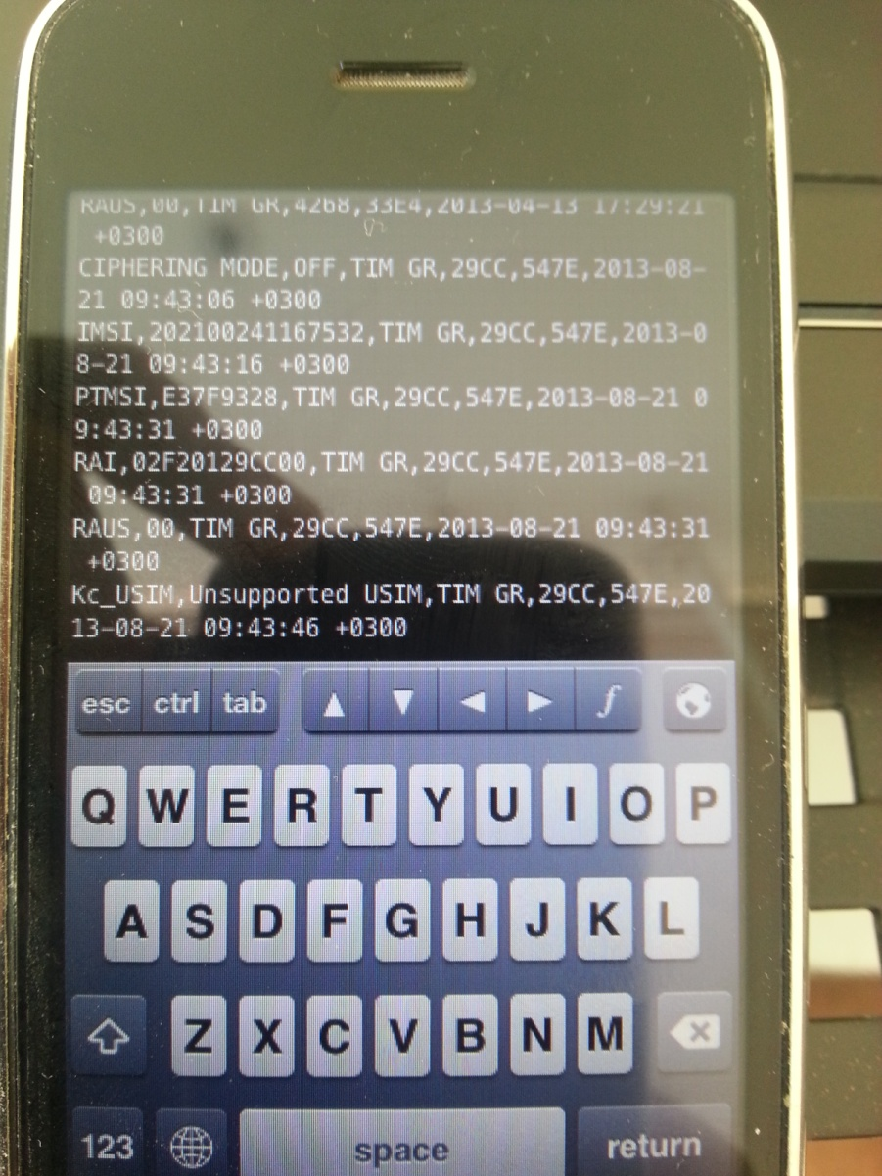
2G/3G/4G security analyzer - evaluator

Slide 51
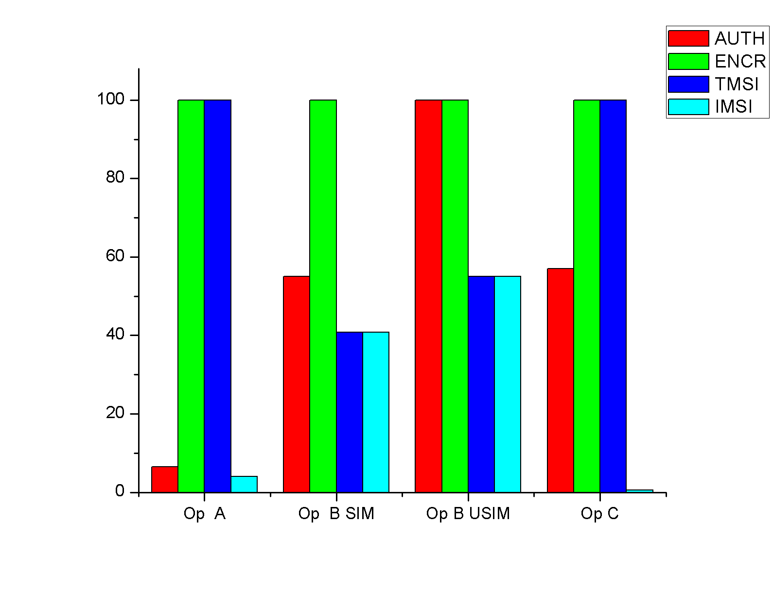
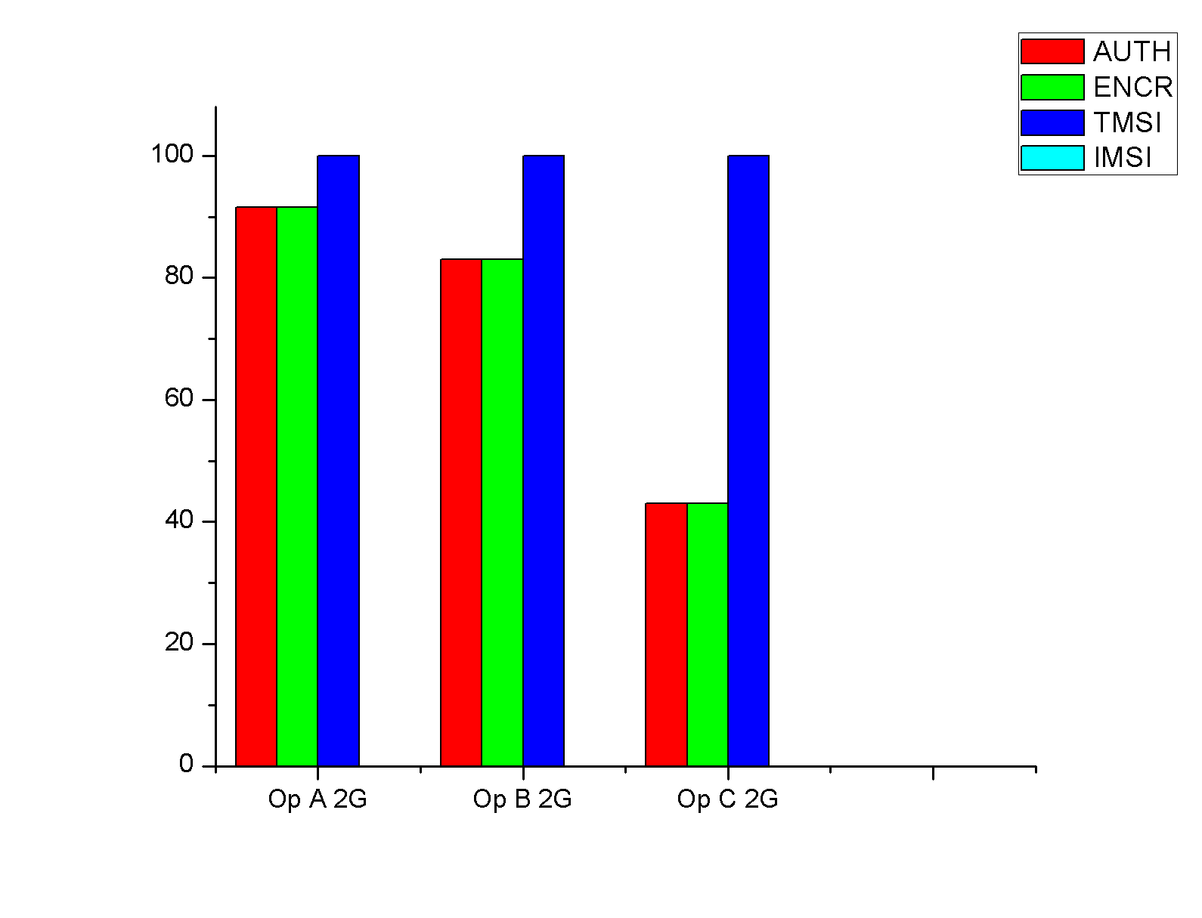
2G/3G/4G security analyzer - evaluator

Slide 52
2G/3G/4G security analyzer - evaluator
Such a tool can be used for the:
  Definition and acquisition of quantitative security measurements on mobile/wireless networks
  Determination of security metrics for mobile/wireless networks
  Proposal of novel, quantitative risk modeling and risk assessment approaches
  Proposal of novel, quantitative security modeling approaches

Slide 53
Forensics investigations on smart phones
We have investigated on the recovery of authentication credentials (i.e., username & passwords) from the volatile memory of Android mobile devices
We examined 13 security critical Android Apps in 30 different scenarios
  Mobile banking, E-shopping/financial applications, password managers, encryption and data hiding applications
Innovation: we used open source and free tools (i.e., no cost)
We may use this research for forensic, anti-forensic, user awareness, or application evaluation purposes

Slide 54
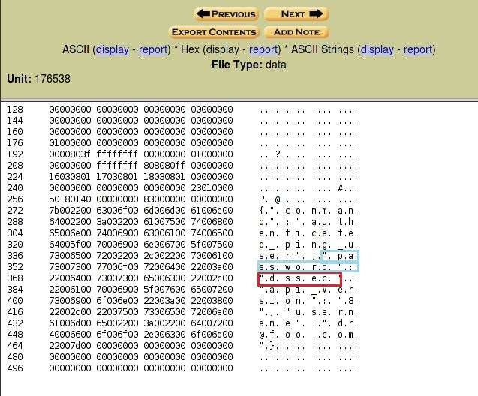
Forensics investigations on smart phones

Slide 55
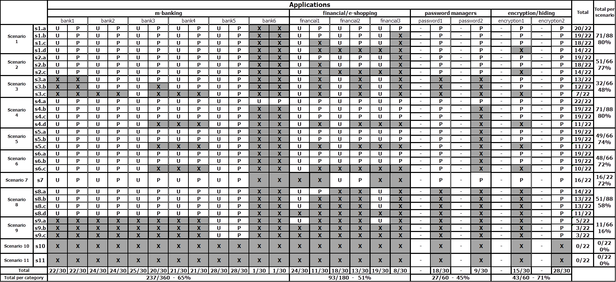
Forensics investigations on smart phones

Slide 56
Forensics investigations on smart phones
We may use the acquired knowledge to
  Propose new forensic approaches on computers, embedded devices, smart devices, etc.
  Evaluate cloud services/data under forensic investigations.
  Determine users privacy under forensic investigations on smart devices, computer, network forensics, cloud services, etc.
  Propose novel tools that enhance users privacy

Slide 57
Creation of groups over public networks
We have designed and developed a P2P communication platform for creating, on demand, groups of users over IP networks
Innovation: it is an intelligent, scalable, semi-autonomous and fault tolerant system
It uses artificial intelligence and semantic matching
It provides:
  Closed groups, secure communications, anonymous services, autonomous communities, geo-location peer-to-peer services, multimedia services, etc.

Slide 58
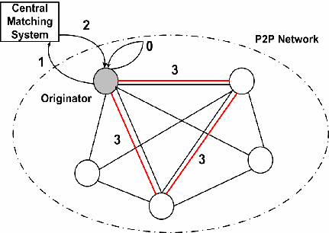
Creation of groups over public networks

Slide 59
Creation of groups over public networks
Such a platform can be used for
  Autonomous service provision over closed – controlled groups of users
  Innovative service provision over the cloud environment
  Autonomous management and access control on cloud services
  Distributed and dynamic trust management for cloud services
  Peer to peer over cloud

Slide 60
Intrusion detection for embedded devices
We have designed and developed lightweight detection engines, using artificial intelligence and specification techniques
Innovation: they can be applied on devices with limited capabilities
  Mobile ad hoc networks, Internet of Things, sensor networks, smart meters, etc.
  They present low false positives and negatives
We have also designed and developed attestation techniques and trusted computation environments

Slide 61
Intrusion detection for embedded devices
We have also designed and developed attestation techniques and trusted computation environments

Slide 62
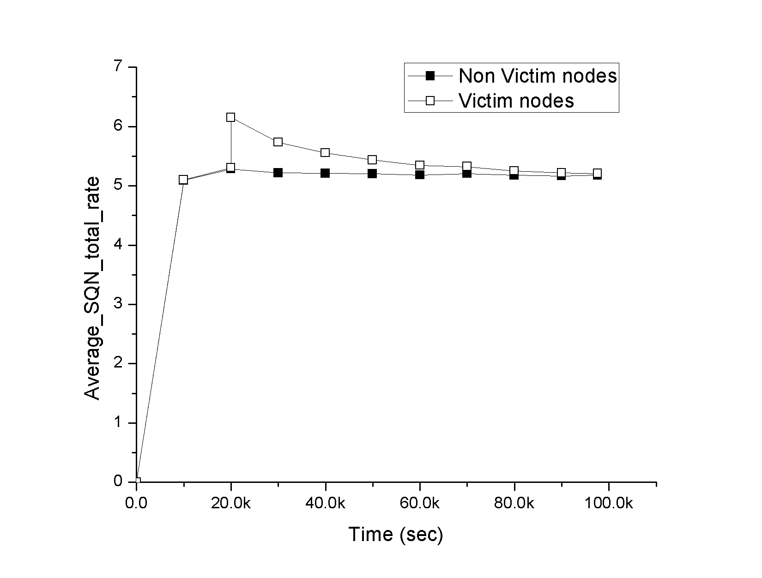
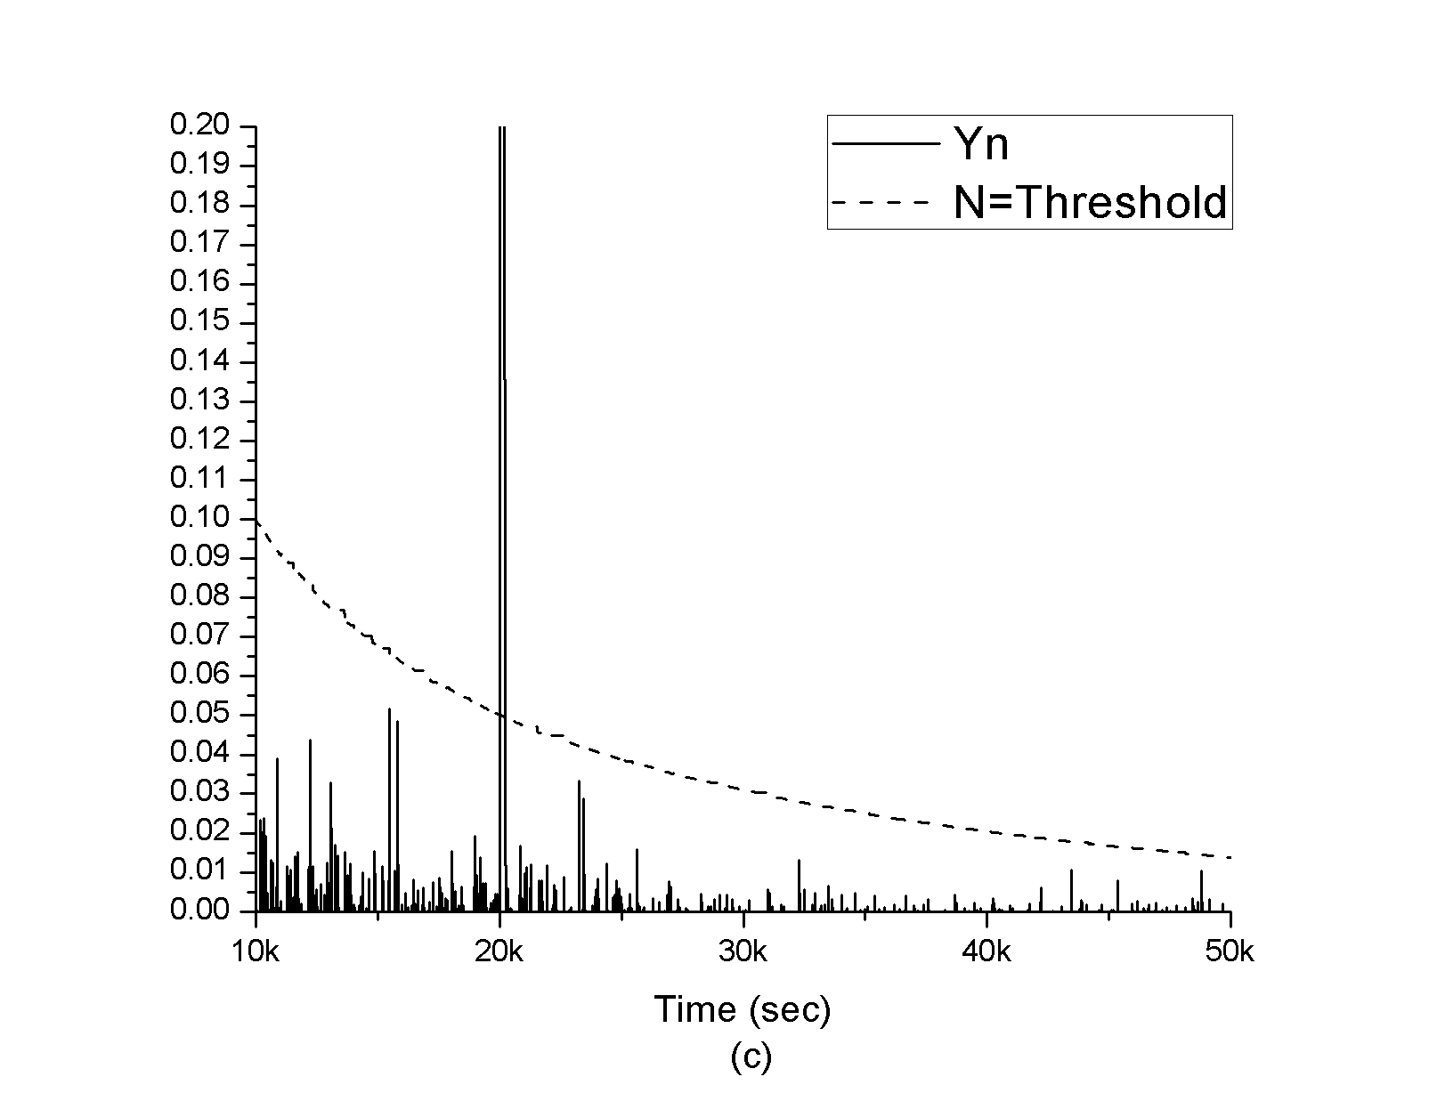
Intrusion detection for embedded devices

Slide 63
Biometric authentication
We have designed and developed mechanisms and algorithms for protecting biometric data transmission and storage
  Fingerprints, iris, face geometry, walking, etc.
They can be used for users’ authentication in controlled environments
Innovations:
  Process multi-modal biometrics
  Enable revocation of the biometric signatures
  Ensure users’ privacy and systems’ integrity

Slide 64
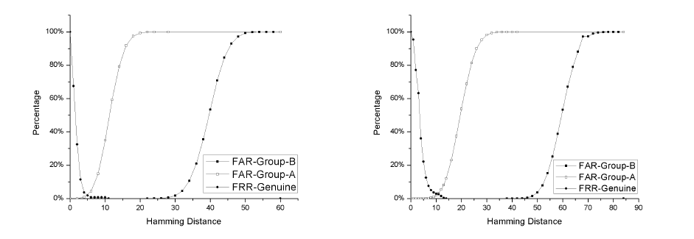
Biometric authentication

Slide 65
Biometric authentication
Such biometric technology can be used for
  Authentication and access control in cloud services
  Secure biometric storage
  Authentication and access control in controlled environment
  E-passports applications
  Authentication and access control using smart devices
  ……….

Slide 66
Security for Smart Grid
We have designed an autonomous, scalable, distributed and decentralized authentication system
  It also provides key management and trust management, including reputation models
Innovation: there is no need for a trust third party ➔ minimizes the managerial overhead.
  It is suitable for large scale and dynamic environment like Smart Grid
  It may cooperate with other security solutions (IDS, remote attestation, trust execution platform, etc)
  It can be developed and implemented in a small scale test bed.

Slide 67
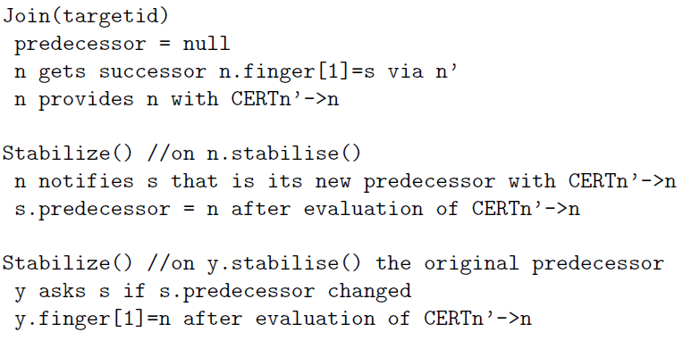
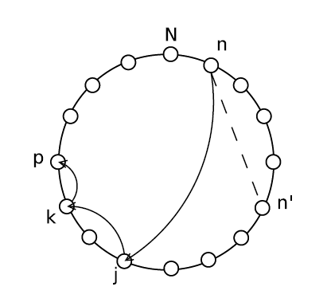
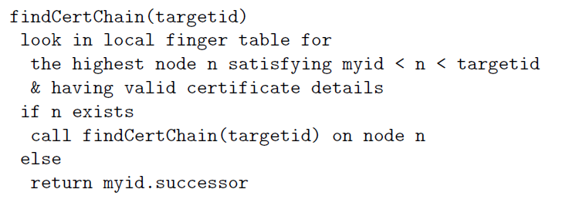
Security for Smart Grid

Slide 68
Security Evaluation
Theoretical, experimental, manual and automated evaluation of the security supported by
  Mobile/wireless technology
  Internet services
  Mobile devices
  Smart devices
  Embedded devises
  ……….

Slide 69
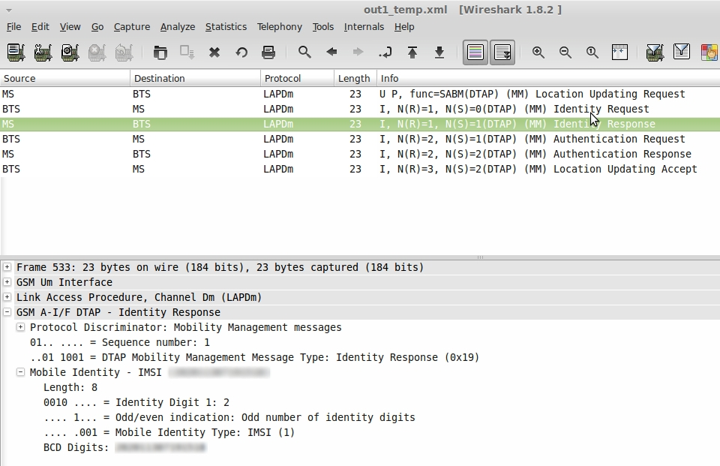
Security Evaluation
We have identified and proved some zero-day vulnerabilities of the 3G network
We have reveal an Advanced Persistent Threat (APT) in 3G networks that aims to flood an HLR/AuC of a mobile operator.

Slide 70
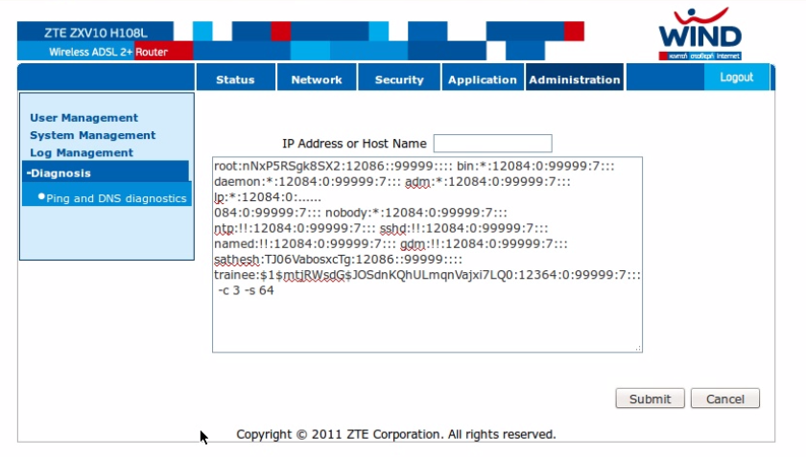
Security Evaluation
Embedded devices
  We have discovered two 0-day vulnerabilities in the web management interface of a popular ADSL router

Slide 71
LEGAL REGULATION OF ATTACKS AGAINST INFORMATION SYSTEMS
IGLEZAKIS, SYNODINOU, JOUGLEUX, MITROU

Slide 72
Outline
3
I. ATTACKS AGAINST INFORMATION SYSTEMS: TECHNICAL DEFINITIONS
II. THE REPRESSION OF CYBERCRIME
III. CYBERCRIME PREVENTION
IV. LEGAL CONSEQUENCES OF CYBERCRIME

Slide 73
I. ATTACKS AGAINST INFORMATION SYSTEMS: TECHNICAL DEFINITIONS
A) VARIOUS TYPES AND METHODS OF ATTACKS
  Hacking, fishing, cracking, Ddos attack, Trojan horse, malware program, sniffing.
B) THE EXTENSIVE NOTION OF “INFORMATION SYSTEMS”
  Computers, ATM, cell phones.

Slide 74
II. THE REPRESSION OF ATTACKS
A) THE OFFENSES
  1. THE EVOLUTION OF THE LEGAL FRAMEWORK
  2. THE ILLEGAL ACCESS TO INFORMATION SYSTEMS
  3. ILLEGAL SYSTEM INTERFERENCE
  4. ILLEGAL DATA INTERFERENCE
  5. ILLEGAL INTERCEPTION
  6. COMPARATIVE ASPECTS OF THE LEGAL FRAMEWORK

Slide 75
B) THE ENFORCEMENT OF LEGISLATION AND THE PROBLEM OF EVIDENCE
1. THE PROOF OF THE ILLEGAL VIOLATION
2. THE CONFLICT BETWEEN CYBERCRIME REPRESSION AND PERSONAL DATA PROTECTION
3. ENFORCEMENT DIFFICULTIES

Slide 76
III. THE PREVENTION OF ATTACKS
A) THE OBSTACLE-CRIMES LEGISLATION
1. ANALYSIS OF ARTICLE 7: TOOLS USED FOR COMMITTING OFFENCES
2. ANALYSIS OF ARTICLE 8: INCITEMENT, AIDING AND ABETTING ATTEMPT

Slide 77
III. THE PREVENTION OF ATTACKS
B) ISSUES OF CYBERCRIME PREVENTION: A VIOLATION OF HUMAN RIGHTS ?
1. THE INTERNET CONNECTION AS A COMPONENT OF THE RIGHT OF EXPRESSION
2. SITE BLOCKING AT AN ISP LEVEL AND ITS DANGERS

Slide 78
IV. LEGAL CONSEQUENCES OF THE ATTACKS
A) THE DATA BREACH NOTIFICATION OBLIGATION
  1. THE ISSUE
  2. COMPARATIVE AND HISTORIC APPROACH
  3. TOWARDS A GENERALIZATION OF THE DATA BREACH NOTIFICATION OBLIGATION

Slide 79
B) CYBERCRIME AS A TOOL TO THE ACHIEVEMENT OF OTHER OFFENSES
1. SOCIOLOGY OF HACKING: THE ENEMY FROM INSIDE
2. CYBERCRIME AS A PARALLEL ECONOMY

Slide 80
Cybercrime Law
Syllabus Content
Faculty of Law
Aristotle University of Thessaloniki
Ioannis Iglezakis
Assistant Professor

Slide 81
Type, Language, Level and Prerequisites of the course
3
Elective course offered in the Faculty of Law
Language: English
Level of the course is undergraduate (BA)
Prerequisites: None
Number of ECTS credits: 5

Slide 82
Competences to be developed
Application of legal texts in the context of cybercrime
Accessing legal texts
Interpretation of legal texts in context
Presenting information visually and orally

Slide 83
Learning outcomes
To provide an understanding of the phenomenon of cybercrime
To classify the different types of cybercrime in comparative perspective
To study the legal provisions pertaining to cybercrime
To study procedural aspects (jurisdiction & evidence) and investigation of cybercrime

Slide 84
Outline of Lectures
The Evolution & Challenges of Cybercrime
Defining Cybercrime & International Instruments against cybercrimes, Basic terms
Offences where computer is the target; malicious software
Illegal access
Impairment of data, misuse of devices, interception of data
Computer Fraud

Slide 85
Outline of Lectures
Child pornography
Other Sexual offences (grooming, etc.)
Attacks against information systems
Crimes against intellectual property and personal data
Jurisdiction & Evidence
Digital Investigation of Crimes

Slide 86
Suggested Bibliography
J. Clough, Principles of cybercrime, Cambridge University Press 2010
M. Yar, Cybercrime and society, Cybercrime and society, Sage Publications 2006
D. Spinellis (ed.),Computer crimes, cyber-terrorism, child pornography and financial crimes (International Congress of Penal Law), 2004.
I. Walden, Computer crimes and digital investigations, Oxford University Press 2007
T. Douglas & B. Loader, Cybercrime: law enforcement, security and surveillance, London 2000
D. Cullompton, Or. Portland & P. Willan, Computer misuse: response, regulation and the law, 2008.
D. Wall, Cyberspace crime, Ashgate 2003.

Slide 87
CyNC 2013
Cybercrime Network
Conference
FORTH-ICS Part
GCC, Dublin 2013

Slide 88

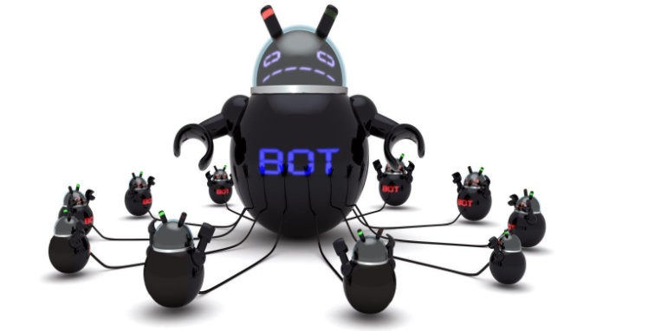
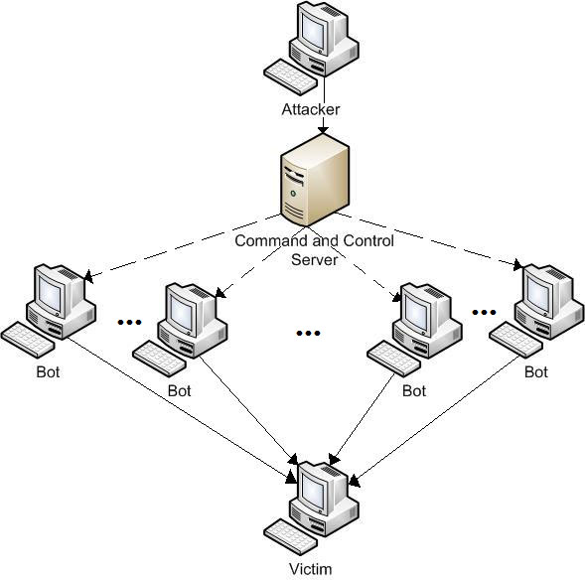
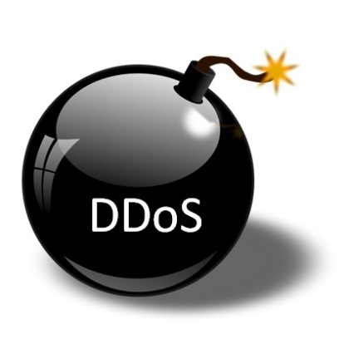
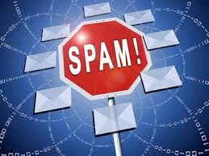
Botnets
3
Network of Compromised Machines under the control
of an Attacker.

Slide 89
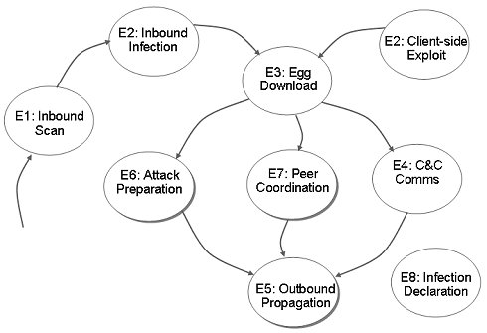

BotHunter
Botnet Diagnosis System
3
Uses a state-based infection sequence model.
BotHunter correlator computes an “anomaly score” and generates a bot profile.

Slide 90
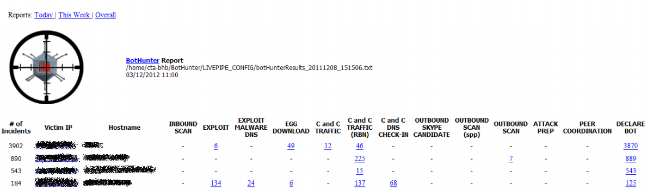

GCC – Botnet Detection
WP 4.2
3
BotHunter is deployed in the external interface of FORTH.
  Manual configuration performed in order to reduce 90% of false positives.
  Daily reports/incidents are being examined by the local administrator.

Slide 91


Honeypots
3
“Any security resource who’s value lies in being probed, attacked, or compromised”
Mimic production resources
Emulate vulnerable services
Monitor activity
Detect unauthorized usage

Slide 92




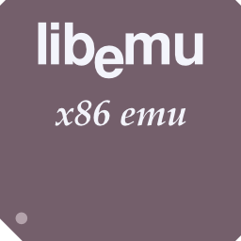

Dionaea Honeypot
3
Low interaction Honeypot
Easy to install and configure.
Emulates all well known services.
  HTTP
  HTTPS
  TFTP
  SMB
  MSSQL
  MySQL.

Slide 93
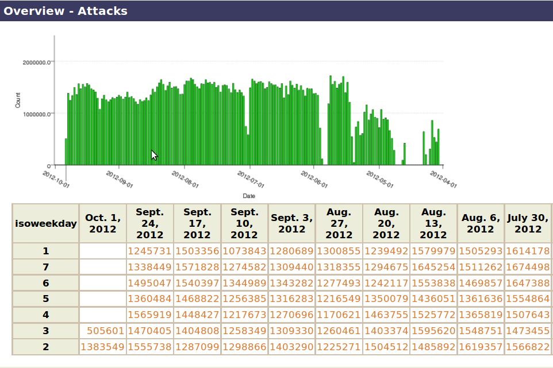
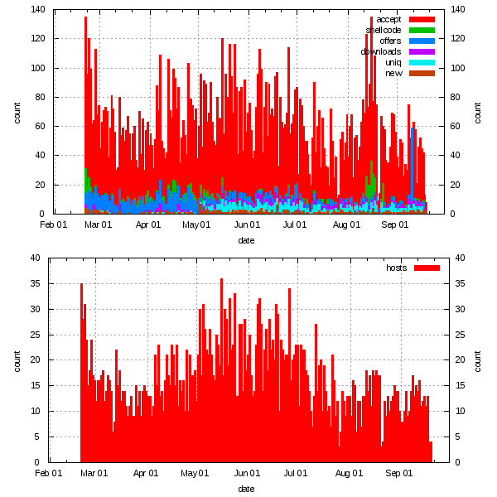
GCC - Honeypots
3
We have deployed Dionaea honeypot at FORTH.
  Approximately 1700 IPs are being monitored.
  Millions of incidents logged.

Slide 94

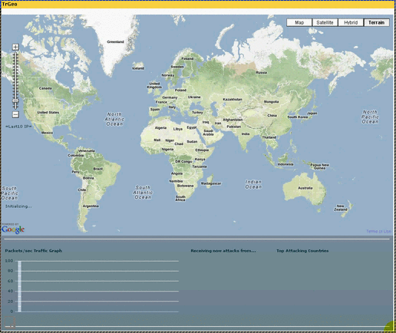
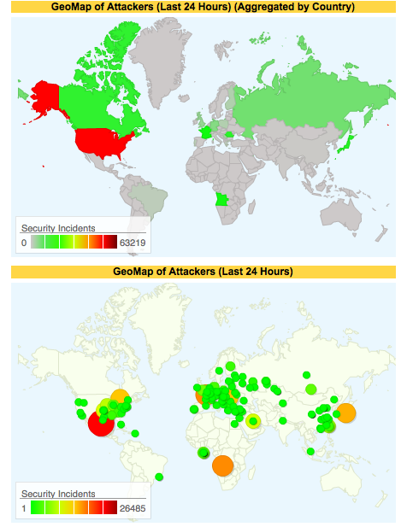
NoAH
European Network of Affined Honeypots
3
A distributed infrastructure of honeypots
Initially, based on ARGOS honeypot and later
on AMUN honeypot.

Slide 95
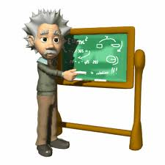


GCC – Public Repository
WP 3.3
3
An Education Portal for educators,
trainees and students.
Focus on delivering Educational
Material to the Public.
We expect all Greek students
interested in the area to benefit
from this task.

Slide 96




GCC – Public Repository
Open eClass
3
An open-source Course Management
System.
Developed by the Greek Academic
Network (GUnet).
Provides a Digital Teaching Environment

Slide 97
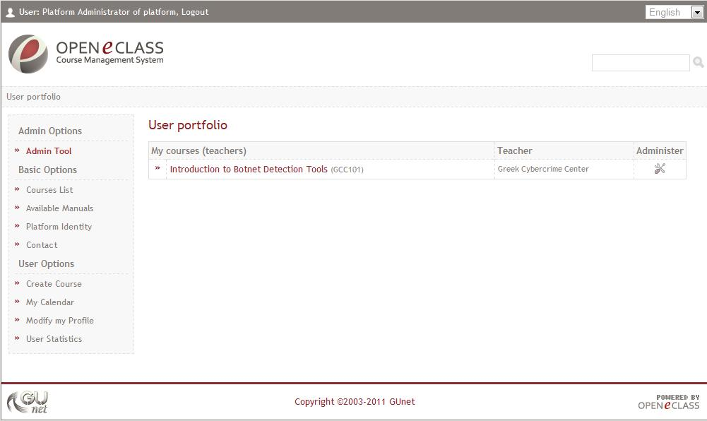

GCC – Public Repository
Open eClass
3
q

Slide 98
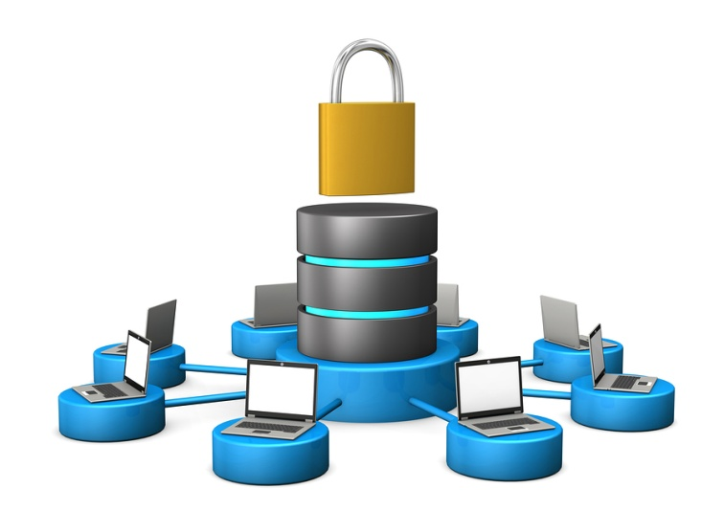
GCC – Private Repository
WP 3.4
3
Focus on designing and creating a
Secure Private Repository
Threat Modeling
&
Secure
Architecture Design

Slide 99
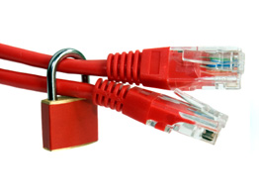
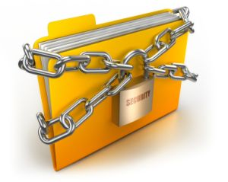
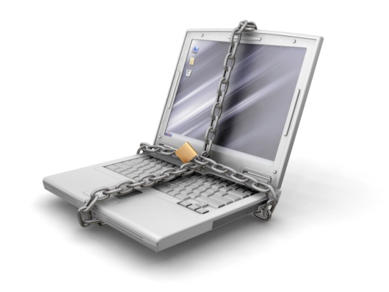

GCC – Private Repository
Security Levels
3
Network Content
Host Application

Slide 100
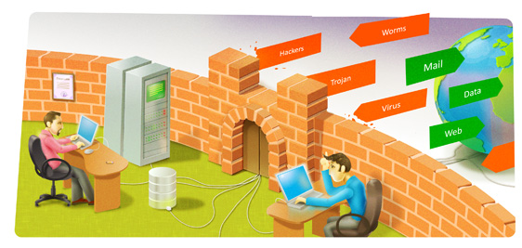



GCC – Private Repository
Security Levels
3
Network Level
  Firewalls
  Network Intrusion Detection Systems
  VPN access

Slide 101
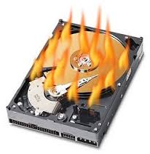

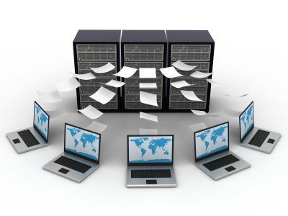
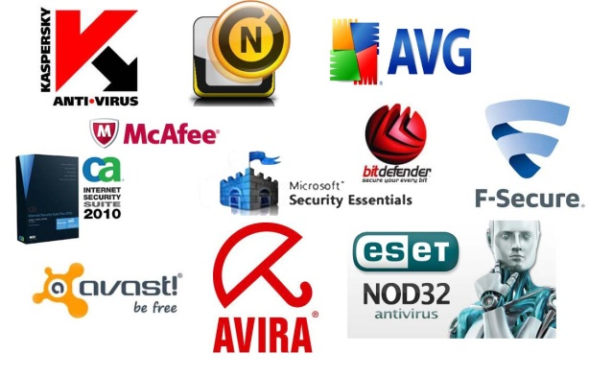
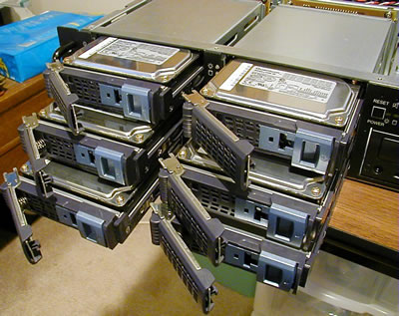
GCC – Private Repository
Security Levels
3
Host Level
Protection against Data Loss
  and Malicious Users
  Backups Antivirus
  RAIDs

Slide 102



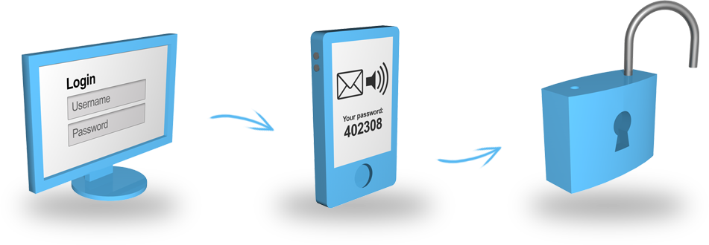
GCC – Private Repository
Security Levels
3
Application Level
Two-factor
Certificates authentication
Secure Access
One Time Passwords (OTP)

Slide 103
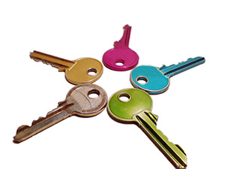
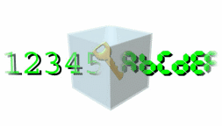

GCC – Private Repository
Security Levels
3
Content Level
Distributed Key Management
Data Encryption
Terms of Use Violation

